Slide 1

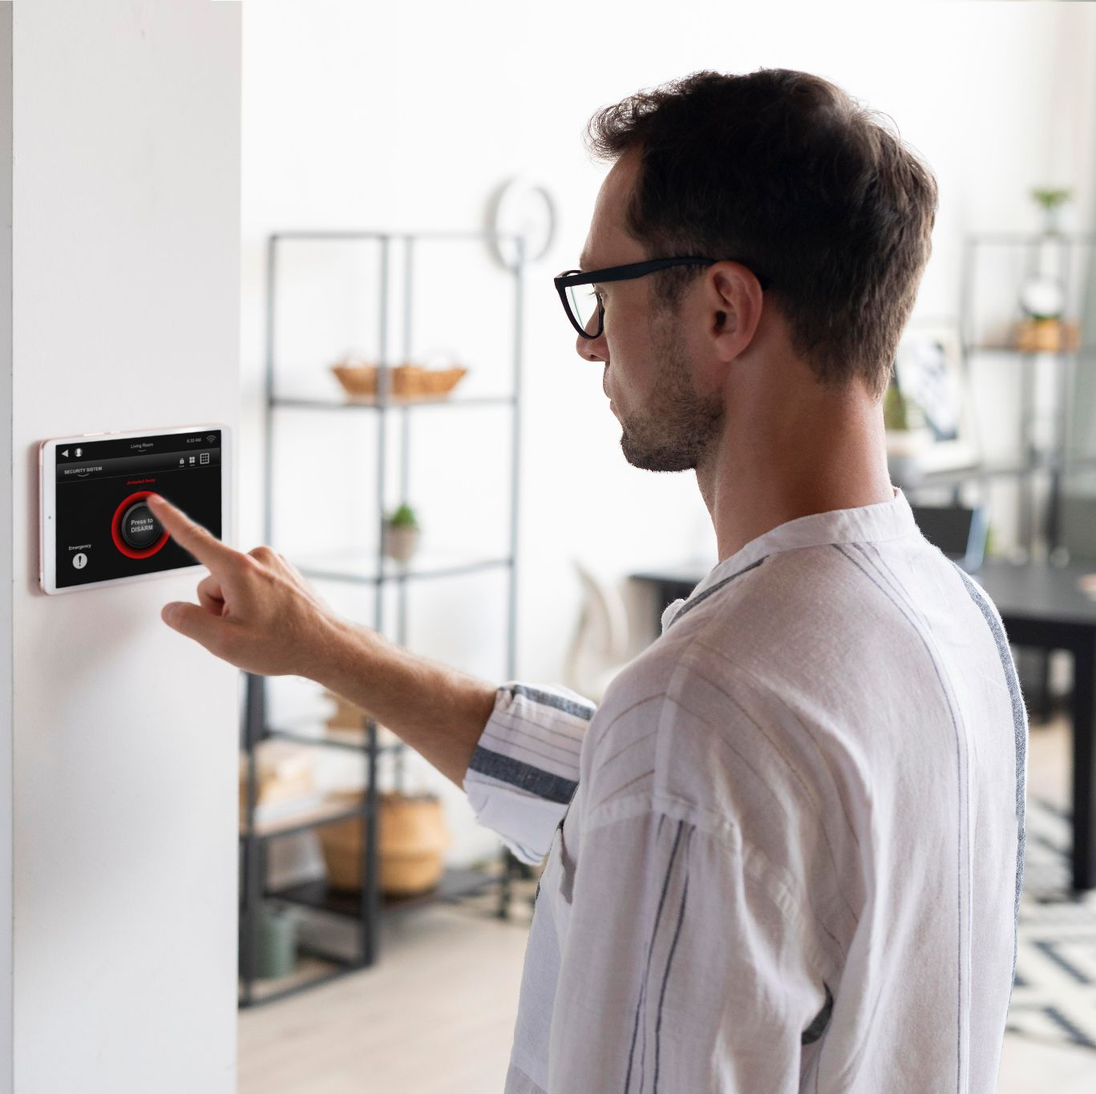
INTRODUCTION TO INFORMATION SECURITY
COURSE CODE: 502049
LECTURERS: HUYNH NGOC TU GROUP: 04

Slide 2
TABLE OF CONTENTS
01
04
SECURITY SCENARIOS
INPUT, OUTPUT OF EACH STEP
02
05
DEMO
TECHNOLOGY USED
03
06
INSTALLATION STEPS
EVALUATION AND CONCLUSION

Slide 3
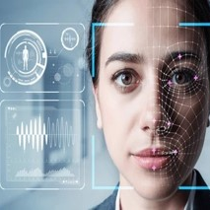
01.
SECURITY SCENARIOS

Slide 4
SECURITY SCENARIOS
Website Security Script Using Face Authentication Context: The web uses facial authentication to ensure user safety when logging in and accessing services. The scenario below describes the process of users registering and logging in using face authentication.

Slide 5
SECURITY SCENARIOS
New user registration page
Goal: Allow new users to sign up for an account and set up face authentication.
Step 1: Enter personal information The user visits the registration page. They fill in personal information fields such as full name, email, password.
Step 2: Register your face After filling in the personal information, the user will be redirected to the face registration section. They click on the "Register face" button, the system will activate the camera to capture the face and take 5 times then the user presses the save button.

Slide 6
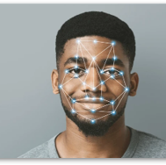
02
TECHNOLOGY USED

Slide 7
TECHNOLOGY USED
OpenCV (OpenCV Library):
OpenCV, which stands for Open Source Computer Vision, is considered one of the leading open source libraries for real-time image processing.
First officially launched in 1999, OpenCV is a free and open source library for both academic and commercial use.
OpenCV supports multiple platforms including Windows, Linux, Mac OS, iOS and Android.
OpenCV supports C/C++, Python and Java programming languages.
OpenCV is written in C/C++ and integrates OpenCL. The library has more than 2500 optimized algorithms.

Slide 8
TECHNOLOGY USED
Dlib:
Dlib is a modern C++ toolkit containing machine learning algorithms and tools for creating complex software in C++ to solve real-world problems. It is used in both industry and academia in many fields including robotics, embedded devices, mobile phones and large high-performance computing environments. Dlib's open-source license allows you to use it in any application for free.
Dlib is a program of the OpenCV library, which assists users in identifying faces. The algorithm that Dlib uses is HOG (Histogram of Oriented Gradients) and SVM (Support Vector Machine), which is why Dlib has a very small runtime and can be used in real-time systems. More recently, however, Dlib has also provided additional CNN-based face-recognition functions.

Slide 9
TECHNOLOGY USED
What is Flask Python?
Flask is a micro web framework written in Python. "Micro" means that Flask does not require any additional third-party tools or libraries to work. This makes the framework flexible and easy to get started with while ensuring it provides enough features to build web applications from small projects to more complex systems.
In the context of face recognition, Flask can be used to create a web application that allows users to upload images and recognize faces from those images. This is a basic example of how to use Flask in conjunction with face_recognition facial recognition library in Python.

Slide 10
TECHNOLOGY USED
Flask:
Flask offers basic features such as URL routing, user interface creation, request handling, and HTTP responses. In addition, it also supports extended features through Flask extensions libraries to add functions such as user authentication, database connections, session management, and many others.
Python Flask was created and developed by Armin Ronacher when he was a student at the Technical University of the Bremen Institute, Germany. Flask was first released in 2010 and has become one of the most popular Python web frameworks ever since.

Slide 11
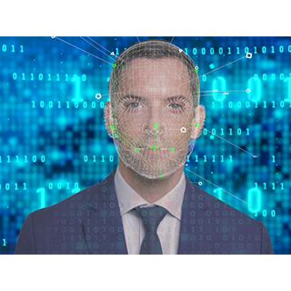
03
INSTALLATION STEPS

Slide 12

INSTALLATION STEPS
Install dlib library:
Install OpenCV library:
Install Flask:

Slide 13
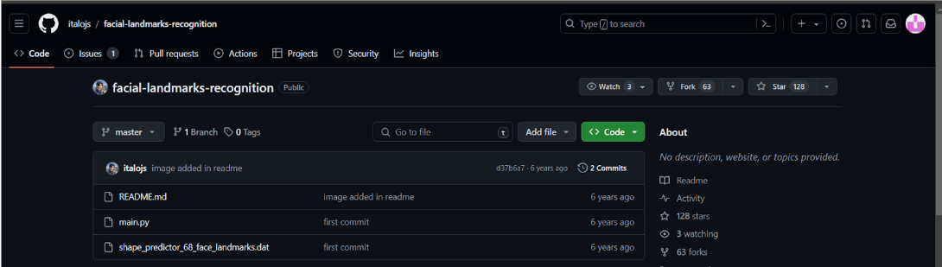
INSTALLATION STEPS
Download file shape_predictor_68_face_landmarks.dat
Build source code
Details are provided in the accompanying source code zip file.

Slide 14
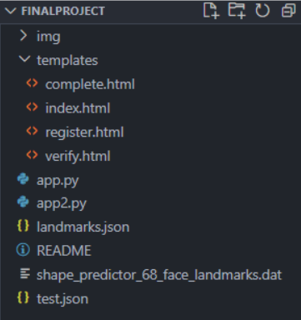
INSTALLATION STEPS
Complete directory

Slide 15
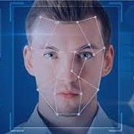
04
INPUT, OUTPUT OF EACH STEP

Slide 16
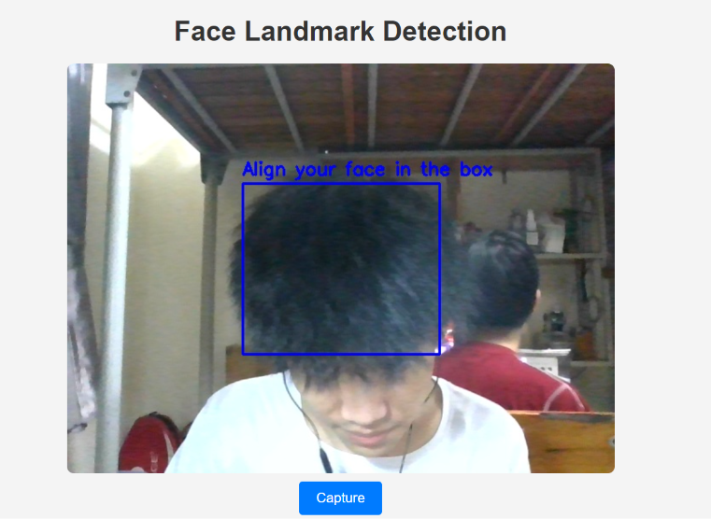
INPUT, OUTPUT OF EACH STEP
Step 1: Registration
Face Scanning:
The system activates your device's camera to capture your face.
A blue overlay (frame) appears on the screen, guiding you to position your face squarely within the frame. This ensures optimal image capture for accurate feature extraction.

Slide 17
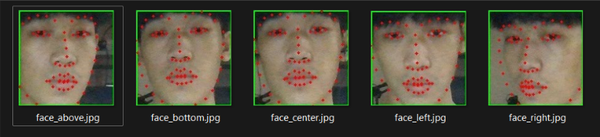
INPUT, OUTPUT OF EACH STEP
Step 1: Registration
Facial Feature Extraction:
The cv2 library (typically used for computer vision tasks in Python) efficiently detects your face in the captured image.
The powerful dlib library comes into play to extract a set of key facial features (e.g., distance between your eyes, shape of your eyebrows, etc.). These features form a unique representation of your face.
Output :

Slide 18
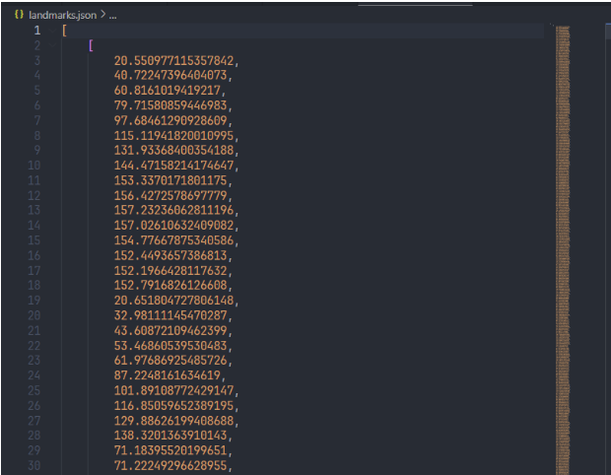
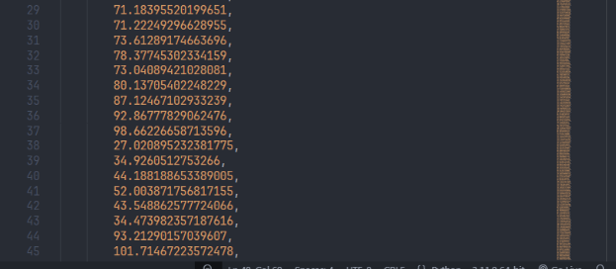
INPUT, OUTPUT OF EACH STEP
Step 2: Calculating Average Distance
The system calculates the average distances between various key facial features in the extracted data. This creates a single value that summarizes the overall geometry of your face.
Output:

Slide 19
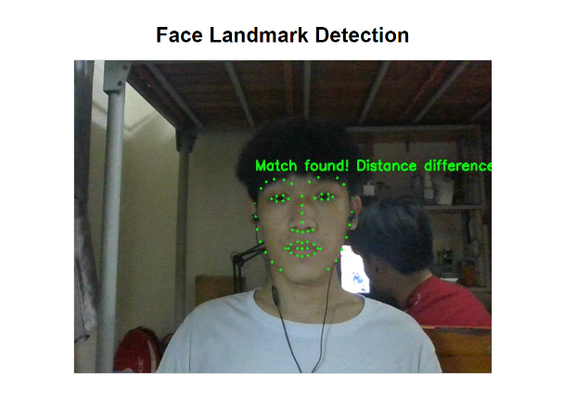
INPUT, OUTPUT OF EACH STEP
Step 3: Face Authentication
Face Scanning:
Similar to Step 1, the system scans your face using the camera.
Feature Extraction and Comparison:
The cv2 and dlib libraries are used once more to extract a new set of facial features from the captured image.
The system compares the newly extracted features with the average distance value stored from your registration process (Step 2).
After the process of testing and checking, we decided to set the benchmark for determining whether a match or a mismatch is 150.

Slide 20
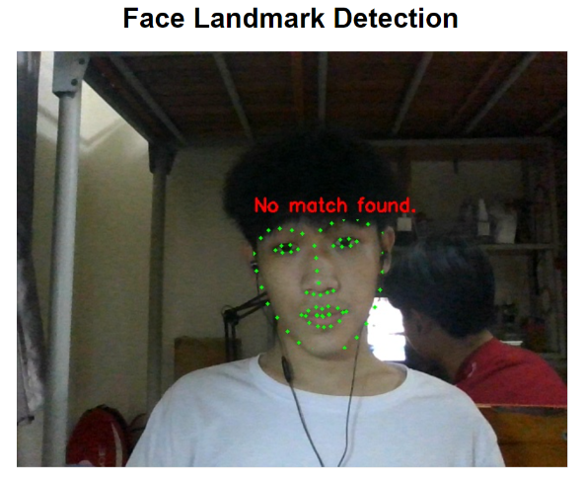
INPUT, OUTPUT OF EACH STEP
Step 3: Face Authentication
Authentication Success:
If the comparison reveals a close match (i.e., the average distances between features are similar), the system authenticates you and grants access (skips to the "complete page").
Authentication Failure:
If the comparison indicates a significant difference (i.e., the average distances deviate substantially), the system denies access, potentially prompting you to re-register or contact an administrator for assistance.

Slide 21
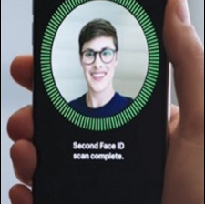
05
DEMO

Slide 22

06
EVALUATION AND CONCLUSION

Slide 23
ADVANTAGES
- Convenience: Quick and easy to use, no need to remember passwords or carry authentication devices.
- No contact: Reduces the risk of spreading bacteria and disease, especially useful during epidemics.
- High accuracy: Advanced facial recognition technology can achieve high accuracy, especially when used in combination with other biometric methods.
- Difficult to copy: Each person's face is unique and difficult to copy, increasing security compared to methods using passwords or cards.

Slide 24
DISADVANTAGES
- Risk of data breach: Facial data is considered sensitive information, which if leaked can lead to serious consequences such as identity theft or fraud.
- Being fooled: Some facial recognition systems can be fooled using techniques such as using fake photos or videos.
- Privacy issues: Collecting and storing facial data can impact individual privacy.
- Cost: Implementing facial recognition systems can be expensive, especially for highly accurate systems.

Slide 25

THANK YOU FOR LISTENING ❤️

